Slide 1

Micro Credit Loan DefaultPrediction
By
Gargi Saha Samanta

Slide 2

Content
Problem Statement
Data Summary
Exploratory Data Analysis
Data Cleaning
EDA on Clean Data
Model Building with Normal Classification techniques
Model Building with Ensemble Classification techniques
Hypertuning the two Best Models
Classification ,Confusion Metrics and ROC –AUC curve
Best Model Selection and Conclusion

Slide 3

Problem Statement
A Microfinance Institution (MFI) is an organization that offers financial services to low income populations. MFS becomes very useful when targeting especially the unbanked poor families living in remote areas with not much sources of income. The Microfinance services (MFS) provided by MFI are Group Loans, Agricultural Loans, Individual Business Loans and so on.
The MFI industry is primarily focusing on low income families and are very useful in such areas, the implementation of MFS has been uneven with both significant challenges and successes.
We are working with one such client that is in Telecom Industry. They are a fixed wireless telecommunications network provider. They have launched various products and have developed its business and organization based on the budget operator model, offering better products at Lower Prices to all value conscious customers through a strategy of disruptive innovation that focuses on the subscriber.
They understand the importance of communication and how it affects a person’s life, thus, focusing on providing their services and products to low income families and poor customers that can help them in the need of hour.
They are collaborating with an MFI to provide micro-credit on mobile balances to be paid back in 5 days. The Consumer is believed to be defaulter if he deviates from the path of paying back the loaned amount within the time duration of 5 days. For the loan amount of 5 (in Indonesian Rupiah), payback amount should be 6 (in Indonesian Rupiah), while, for the loan amount of 10 (in Indonesian Rupiah), the payback amount should be 12 (in Indonesian Rupiah).
Build a model which can be used to predict in terms of a probability for each loan transaction, whether the customer will be paying back the loaned amount within 5 days of insurance of loan. In this case, Label ‘1’ indicates that the loan has been payed i.e. Non- defaulter, while, Label ‘0’ indicates that the loan has not been payed i.e. defaulter.

Slide 4

Data Summary
label: Flag indicating whether the user paid back the credit amount within 5 days of issuing the loan{1:success, 0:failure}
msisdn: mobile number of user
aon :age on cellular network in days
daily_decr30: Daily amount spent from main account,averaged over last 30 days (in Indonesian Rupiah)
daily_decr90: Daily amount spent from main account, averaged over last 90 days (in Indonesian Rupiah)
rental30: Average main account balance over last 30 days
rental90: Average main account balance over last 90 days
last_rech_date_ma: Number of days till last recharge of main account
last_rech_date_da: Number of days till last recharge of data account
last_rech_amt_ma: Amount of last recharge of main account (in Indonesian Rupiah)
cnt_ma_rech30: Number of times main account got recharged in last 30 days
fr_ma_rech30: Frequency of main account recharged in last 30 days

Slide 5
Data Summary
sumamnt_ma_rech30: Total amount of recharge in main account over last 30 days (in Indonesian Rupiah)
medianamnt_ma_rech30: Median of amount of recharges done in main account over last 30 days at user level (in Indonesian Rupiah)
medianmarechprebal30: Median of main account balance just before recharge in last 30 days at user level (in Indonesian Rupiah)
cnt_ma_rech90: Number of times main account got recharged in last 90 days fr_ma_rech90: Frequency of main account recharged in last 90 days
sumamnt_ma_rech90: Total amount of recharge in main account over last 90 days (in Indonasian Rupiah)
medianamnt_ma_rech90: Median of amount of recharges done in main account over last 90 days at user level (in Indonasian Rupiah)
medianmarechprebal90: Median of main account balance just before recharge in last 90 days at user level (in Indonasian Rupiah)
cnt_da_rech30: Number of times data account got recharged in last 30 days

Slide 6
Data Summary
fr_da_rech30: Frequency of data account recharged in last 30 days cnt_da_rech90: Number of times data account got recharged in last 90
days fr_da_rech90: Frequency of data account recharged in last 90 days
cnt_loans30: Number of loans taken by user in last 30 days
amnt_loans30: Total amount of loans taken by user in last 30 days
maxamnt_loans30: maximum amount of loan taken by the user in last 30 days
medianamnt_loans30: Median of amounts of loan taken by the user in last 30 days
cnt_loans90: Number of loans taken by user in last 90 days
amnt_loans90: Total amount of loans taken by user in last 90 days
maxamnt_loans90: maximum amount of loan taken by the user in last 90 days
medianamnt_loans90: Median of amounts of loan taken by the user in last 90 days
payback30: Average payback time in days over last 30 days
payback90: Average payback time in days over last 90 days
pcircle: telecom circle
pdate: date

Slide 7
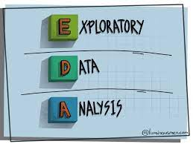
Exploratory Data Analysis ( EDA)

Slide 8
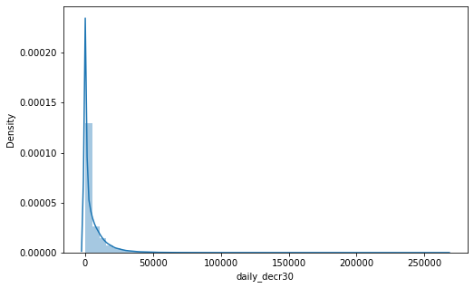
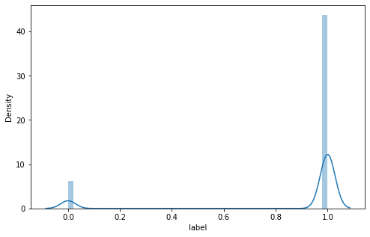
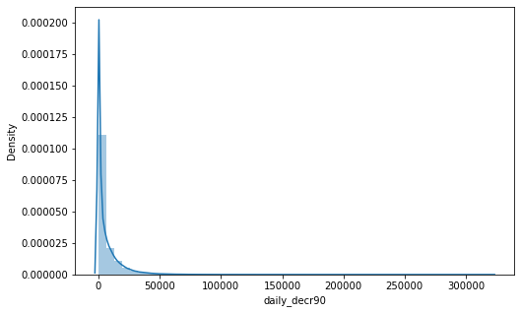
Exploratory Data Analysis of original data
¶
Our target variable is highly imbalanced

Slide 9
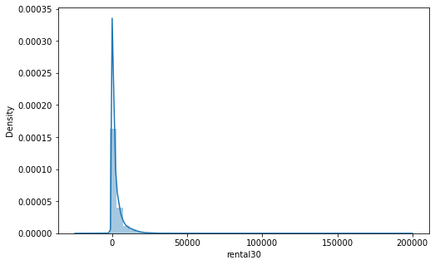
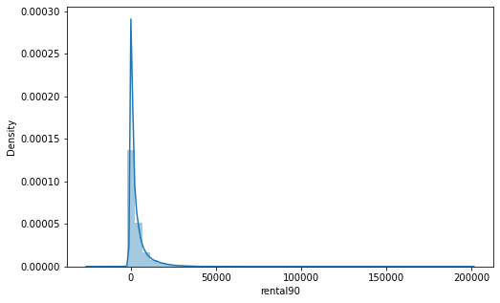
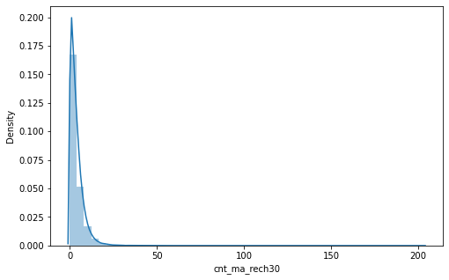
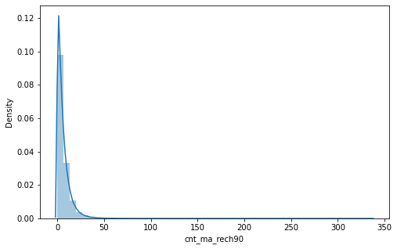
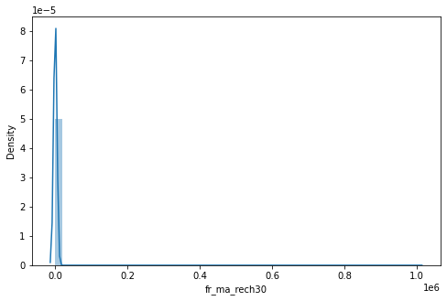
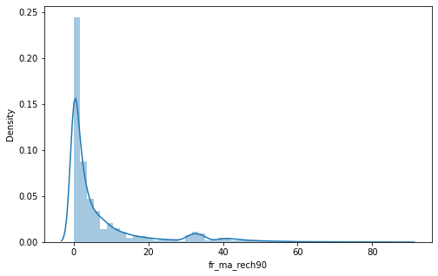
All the data seems to be left skewed

Slide 10
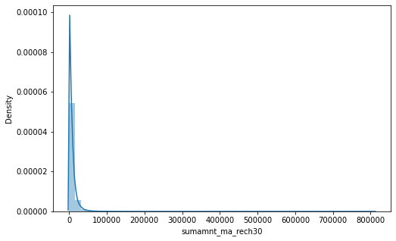
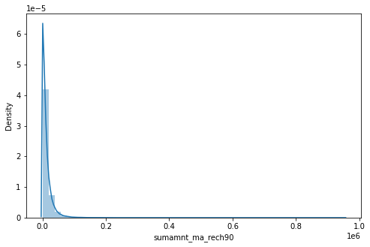
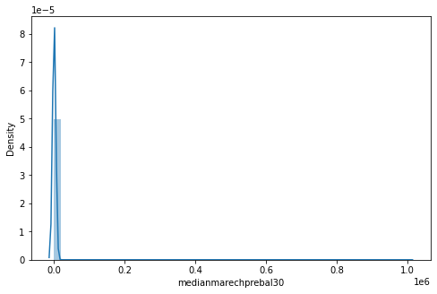
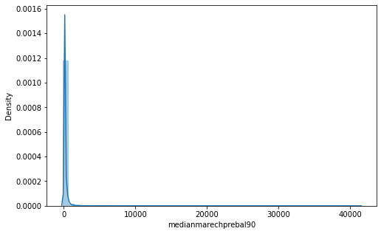
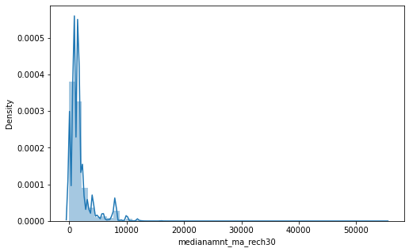
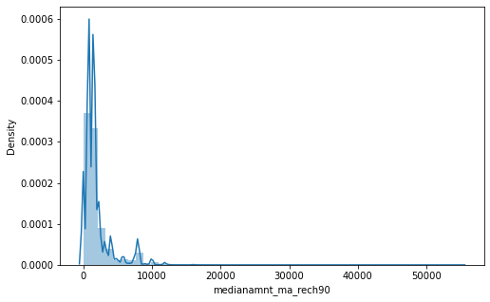
Almost all the data are left skewed

Slide 11
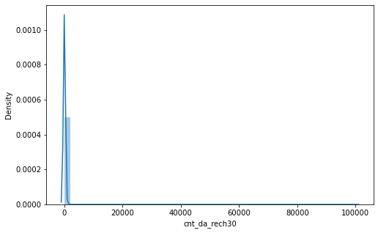
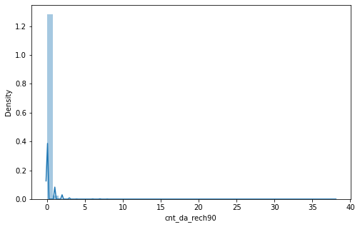
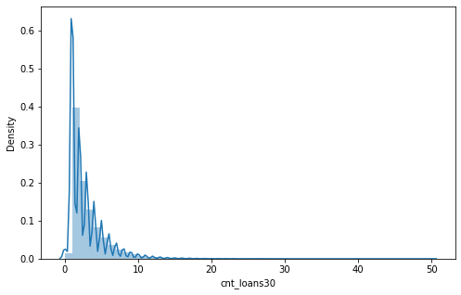
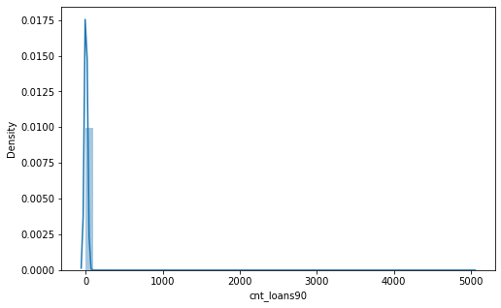

Slide 12
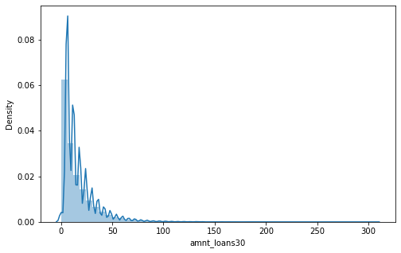
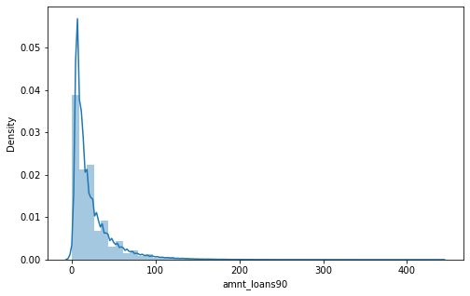
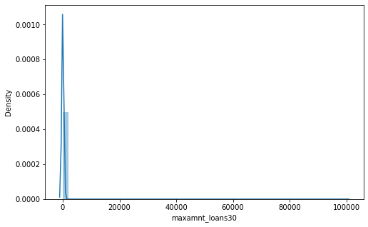
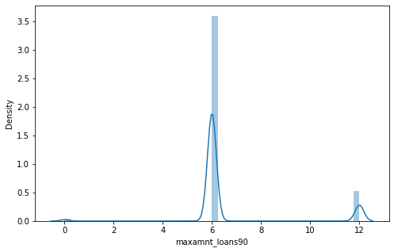
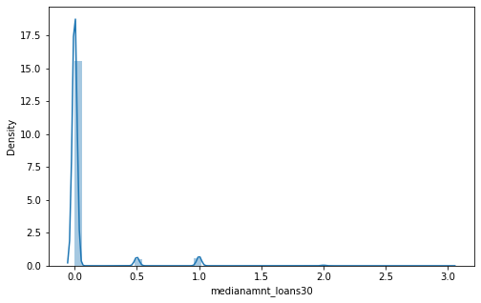
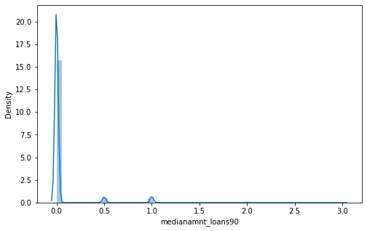

Slide 13
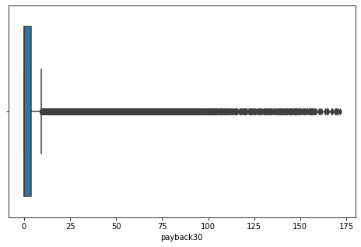
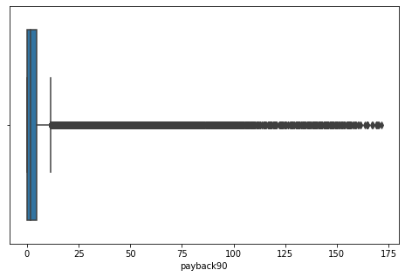
Almost all features are having outliers . Some are treated as its important to treat them for training the model but also some are left unhandled as its normal to have such outliers.

Slide 14
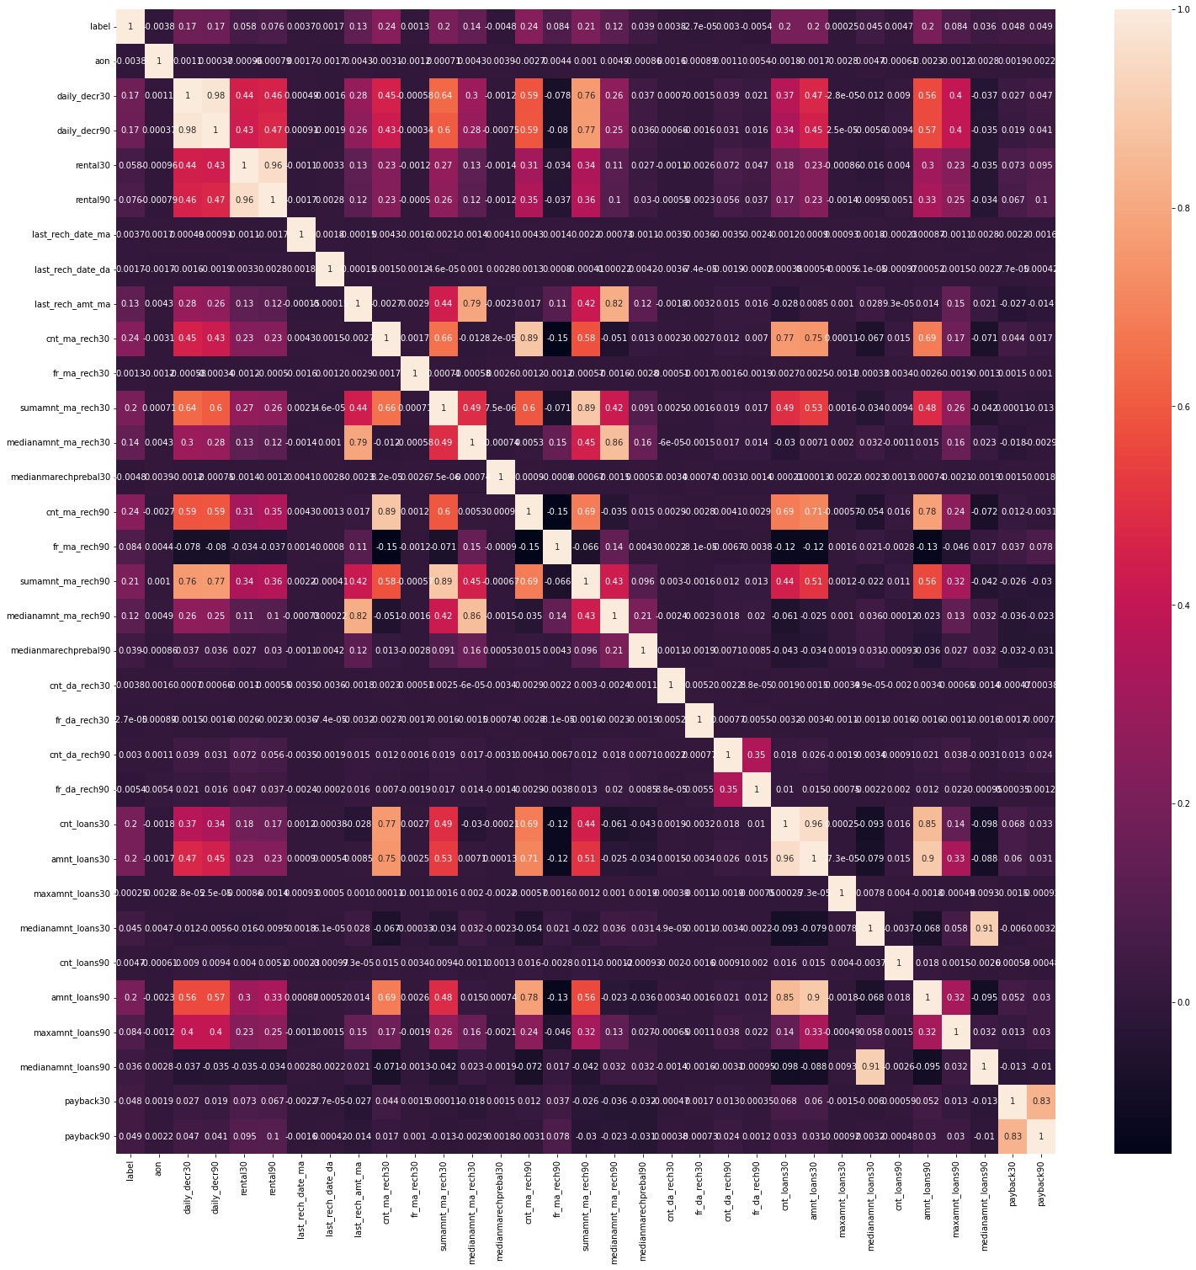
Observation: 1. The payback30 and payback90 show strong negative correlation with the target variable 'label’. 2. Rental30 and rental90 are hioghly correlated to daily_dec30 and daily_dec90. 3. amt_loan 30 and amt_loan 90 are strongly correlated. 4. cnt_amt30 and amt_loan30 are also strongly correlated. 5. medianamnt30 and medianamnt90 are highly correlated to each other. 6. Also some of the features such as amt_ma_rech30, amt_ma_rech90,cnt_ma_reach30 and cnt_ma_rech90 and cntda_reach30 and cnt_da_reach90 are mildly correlated.

Slide 15
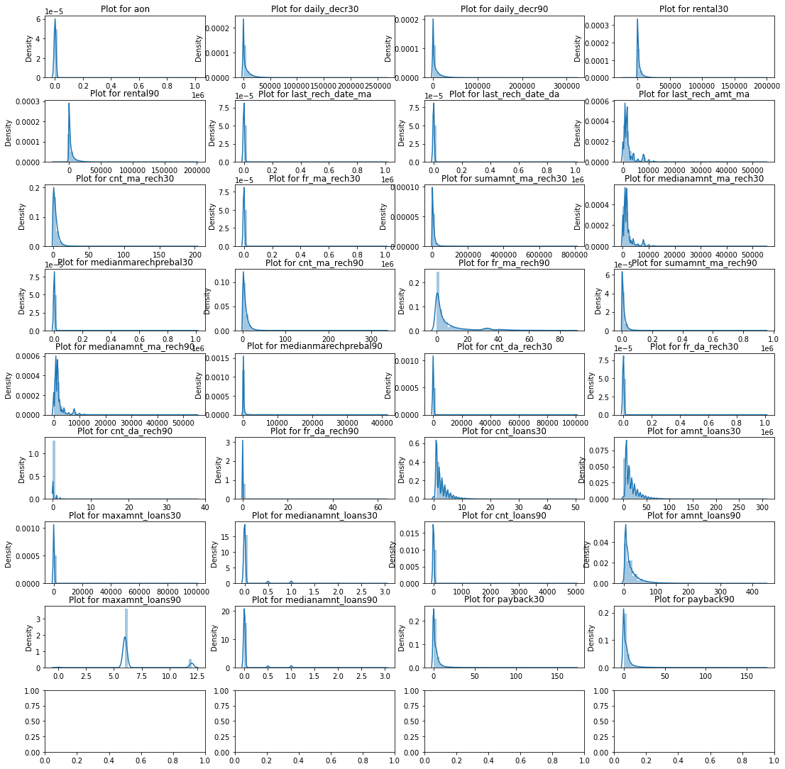
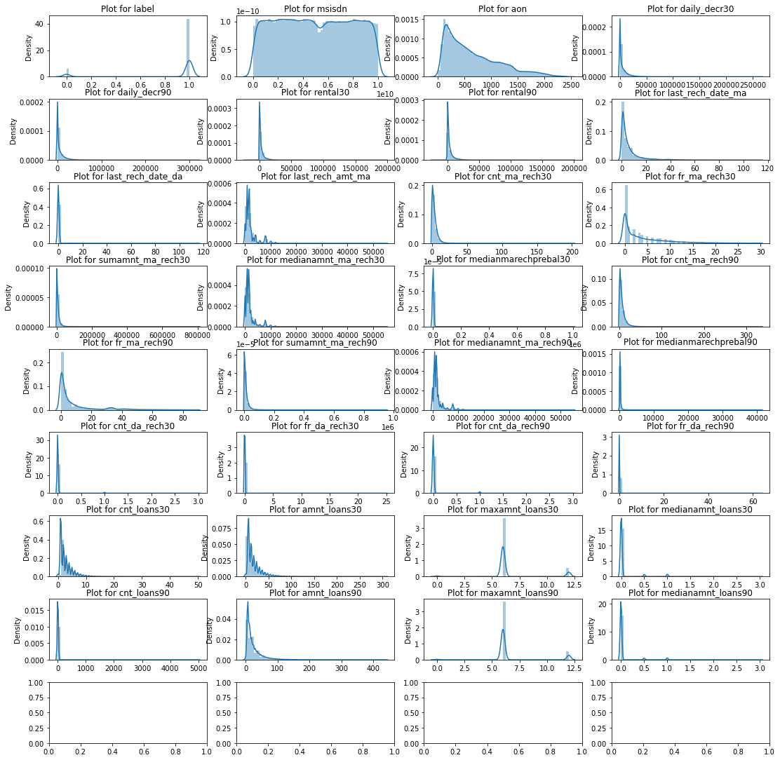
EDA of Numerical features on Clean Data: 1. After cleaning the data we can see some improvements in the data distribution. 2. The distributions still need to be transformed since some data are still skewed and need to be scaled.

Slide 16
Some important inferences that is being made are:
Aon
After cleaning the date, the 'aon' variable can distinguish between the labels 1 and 0.
The tenure of defaulters on an average is lesser than the tenure of defaulters on the cellular network.
daily_decr30
Most of the values are pretty close.
The labels 0 and 1 are somewhat distinguished.
The daily spent amount for 30 days for defaulters is lesser than non defaulters on an average.
daily_decr90
Most of the values are pretty close. The labels 0 and 1 are somewhat distinguished.
The daily spent amount for 90 days for defaulters is slightly lesser than non defaulters on an average.
last_rech_date_ma
The classes 0 and 1 are showing some differences.
The last recharge date on the main account is slightly lesser for non-defaulters than defaulters.
last_rech_amt_ma
The classes 0 and 1 in ‘label’ in distributions are showing some difference.
The last recharged amount on an average for defaulters
fr_ma_rech30
We can see that the distribution of labels 0 &1 and well distinguished in the fr_ma_rech30 after cleaning.Left is before cleaning and right is after cleaning.
The frequency of recharging the main account done for 30 days by non defaulters is greater than defaulters.

Slide 17
Some important inferences that is being made are:
medianamnt_ma_rech30
The graph above shows that the Defaulters have done a slightly lesser amount of recharges to their main account than non-defaulters.
cnt_ma_rech90
On an average, the number of recharges done by the defaulters over 90 days is slightly lesser than the number of recharges done by non-defaulters.
fr_ma_rech90
The classes 0 and 1 show some distinctions.
On an average, the frequency of recharges done by defaulters on the main account over a period of 90 days is lesser than that of non-defaulters.
sumamnt_ma_rech90
On an average, the total amount of recharge done by defaulters over 90 days is slightly lesser than done by non-defaulters.
medianamnt_ma_rech90
The label 0 and 1 distribution in medianamnt_ma_rech90 show some difference.
On an average, the Median amount of recharge done by defaulters on the main account over 90 days is slightly lesser than that done by non-defaulters.
cnt_loan30
The cnt_loans30 distribution shows some difference between labels 0 and 1
On an average, the defaulters have taken a lesser number of loans over 30 days than non defaulters.
amnt_loans30
The amnt_loans30 distribution shows good difference between labels 0 and 1.
The total amount of loans taken by defaulters in the last 30 days is lesser than that of non-defaulters on an average.

Slide 18
Some important inferences that is being made are:
maxamnt_loans30
The distribution means are showing some distinction between labels 0 and 1 for maxamnt_loans30.
The maximum amount taken as loan by defaulters is on an average lesser than the non-defaulters.
amnt_loans90
The distributions between 0 and 1 labels show good difference in amnt_loans90.
On an average, the total amount of loans taken by the defaulters is lesser than non-defaulters.
maxamnt_loans90
On an average, the maximum amount of loans taken by defaulters over a period of 90 days is lesser than the maximum amount of loans taken by non-defaulters.

Slide 19
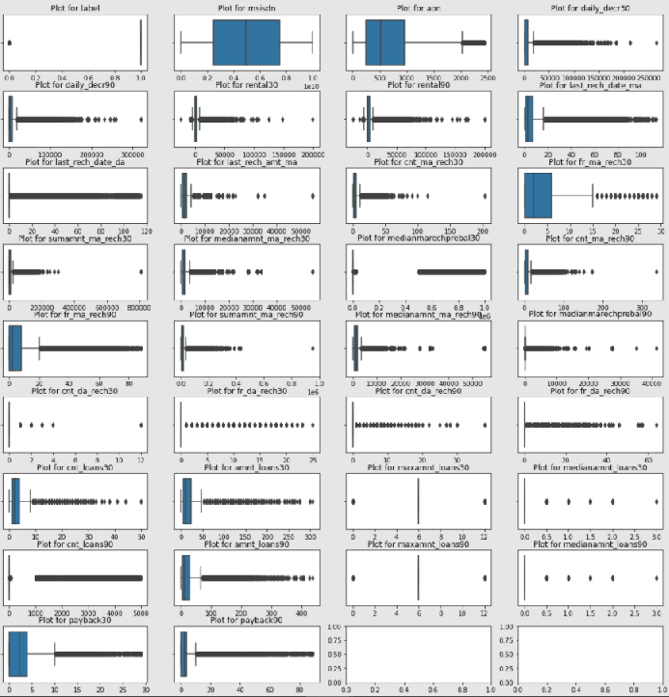
Outliers
As per IQR method, the total percentage of extreme outliers in the data is 46.6%.
Since there is a large percentage of data as outliers, these outliers could be natural outliers.

Slide 20
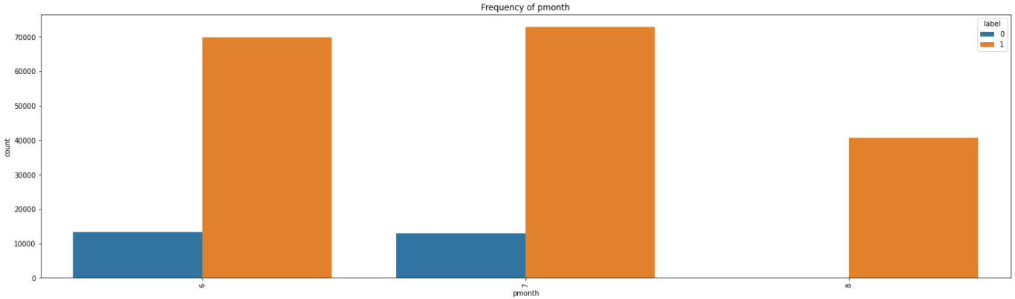
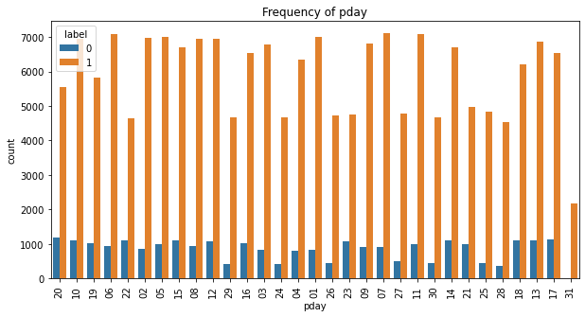
P_month and p_day
Almost on all the dates we have defaulters except on 31
The month of 6 and 7 have some defaulters. Month 8 doesn't have any defaulters.

Slide 21
Conditions that are considered for Data Cleaning activities
Mobile numbers are integers type having an alphabet which we have removed.
Age or number of days are never negative which we have treated.
Extremely large positive values are data entered in either minutes or seconds instead of days.
Amount spent cannot be negative hence that is being handled.
Larger amounts in some feature are very natural as limitations in the data are not given.
In some feature the values of 30 days cannot be more than 90 days value,hence it needs to be handled.
5 and 10 Indonasian Rupiah are the only loan amount options given for the consumer.
There could be records with 0 as the loan amount as well.
Retun amount can be 0,6 and 12 only.
The customer will be a defaulter if they don't pay back the loan amount within 5 days of issuing the loan. So, the Average payback value will be less than or equal to 5 for records with label = 1 and Average payback value to be greater than 5 for records with label = 0.

Slide 22
Steps taken to build the Model:
Performed data cleaning based on the information provided and assumptions made.
Performed Exploratory Data Analysis before and after Data Cleaning.
Handle the skewness.
Trained and validated different Machine Learning classification models(simple and ensemble models) to select a suitable model.
Hypertuning the model.
Choose the final model based on weighted ROC-AUC curve and confusion metrics.

Slide 23
Models used:
Simple Techniques:
LogisticRegression()
DecisionTreeClassifier()
GaussianNB()
SVC()
Ensemble Techniques:
AdaBoostClassifier()
GradientBoostingClassifier()
RandomForestClassifier()
XGBClassifier()

Slide 24
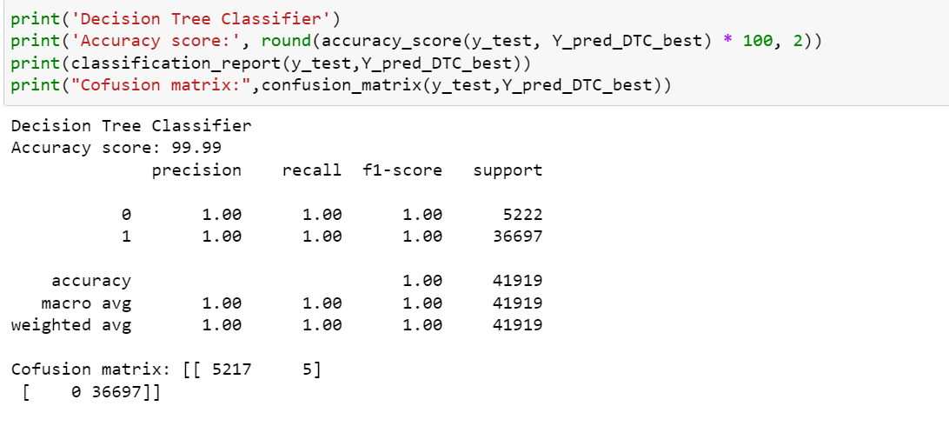
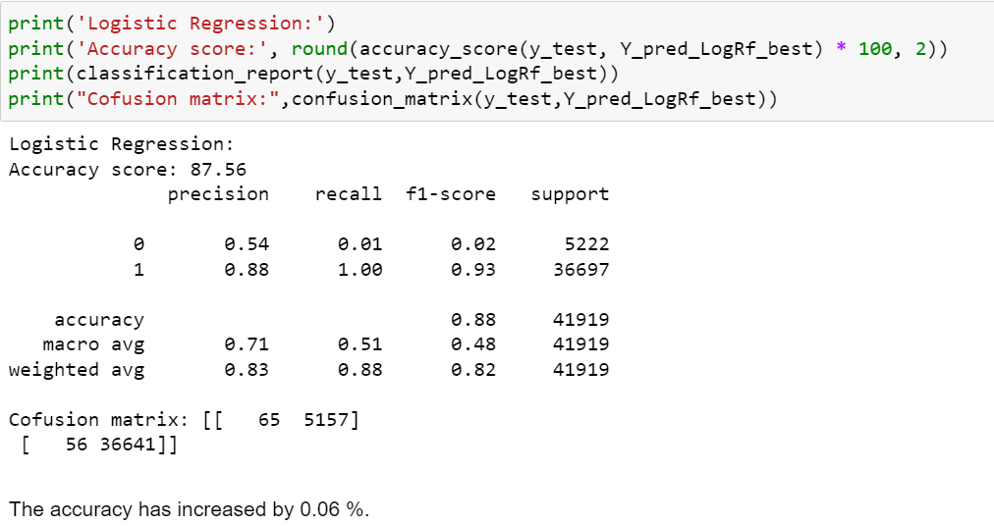
Chosen Decision Tree Classifier Algorithm as my best model with 99.99% accuracy.

Slide 25
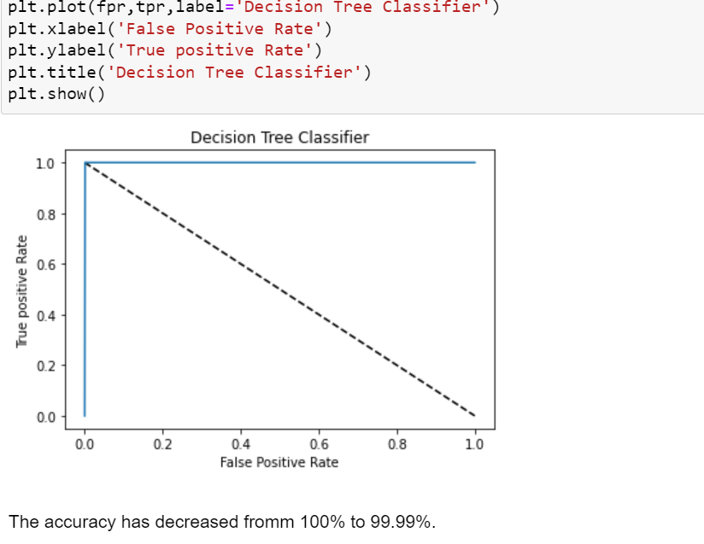
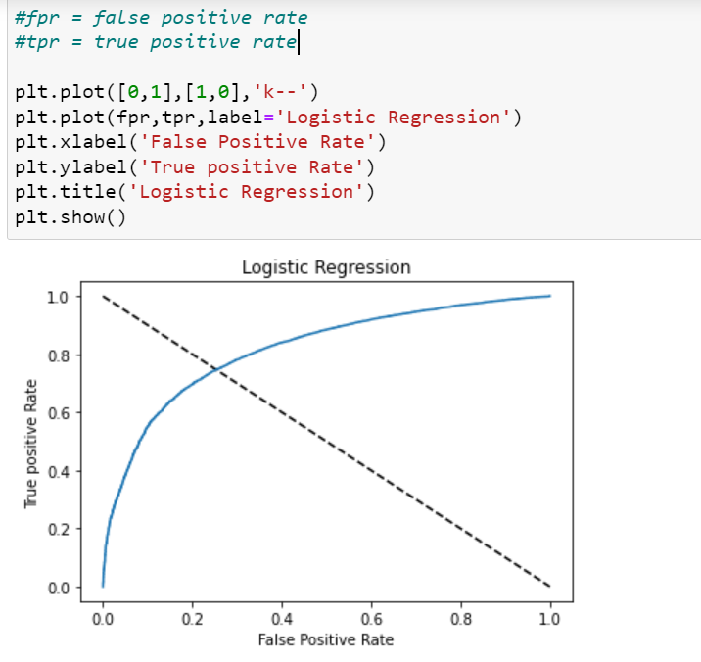
ROC-AUC Curve: It is a plot of positive rate(x-axis) versus the true positive rate(y-axis) for different threshhold

Slide 26
CONCLUSION
Pay Back Observations
After cleaning the payback variables show pretty good difference between labels 0 and 1.
On an average, the time taken by defaulters to pay back the loan is greater than the time taken by non-defaulter to pay back the loan over a period of 30 or 90.
Chosen Decision Tree Classifier Algorithm with 99.99% accuracy as my best model.
Choose the final model based on weighted ROC-AUC curve and confusion metrics.
The performance shows low bias and low variance.

Slide 27


